Slide 1
18ECO133T Sensors and Transducers 3 Credit Course UNIT V
Dr.M.Shunmugathammal
Assistant Professor
Department of ECE
SRMIST Ramapuram Campus

Slide 2
Measurement of Non-Electrical quantity: Introduction Flow Measurement – Introduction. Ultrasonic Flow Meters. Hot Wire Anemometers. Electromagnetic Flow meters. Principle and types Measurement of Displacement. Introduction and types. Measurement of Velocity/ Speed., Introduction and types. Measurement of Liquid Level., Introduction and types. Measurement of Pressure., Introduction and types. Measurement of Vibration., Introduction and types Application of sensors in industries Application of sensors in home appliances

Slide 3
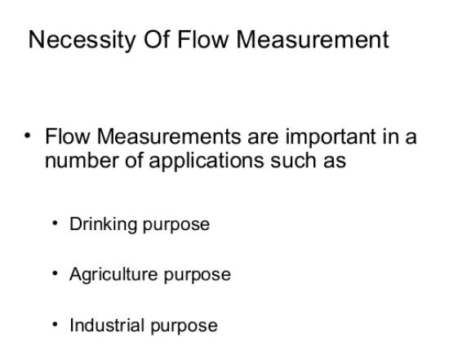
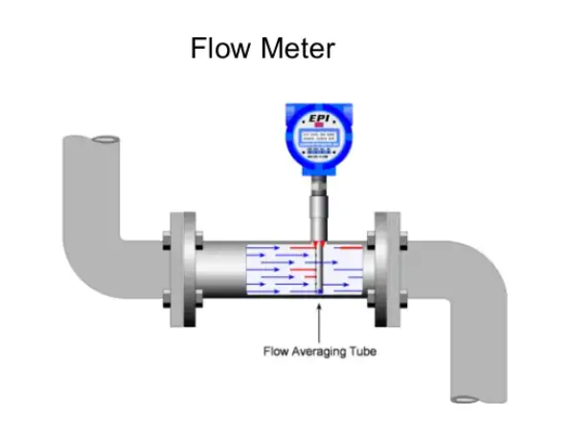

Slide 4
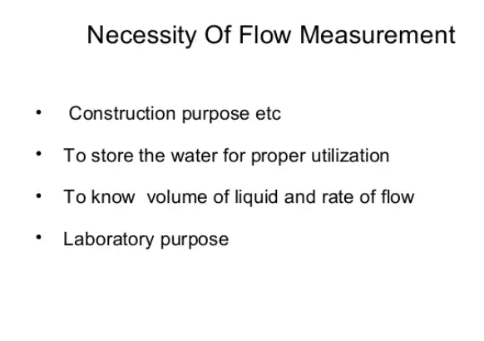
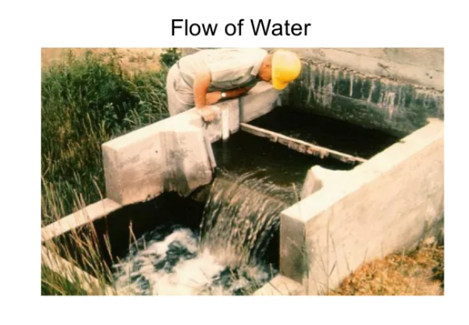

Slide 5
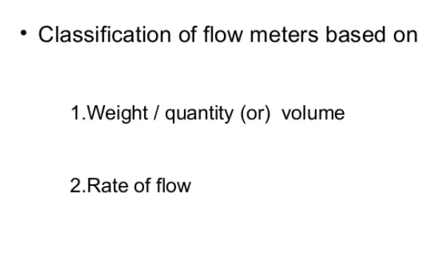

Slide 6
Flow meter
Accurate measurement of flow rate of liquids and gases is an essential requirement for maintaining the quality of industrial processes.
In fact, most of the industrial control loops control the flow rates of incoming liquids or gases in order to achieve the control objective. As a result, accurate measurement of flow rate is very important. Needless to say that there could be diverse requirements of flow measurement, depending upon the situation.
It could be volumetric or mass flow rate, the medium could be gas or liquid, the measurement could be intrusive or nonintrusive, and so on. As a result there are different types of flow measuring techniques that are used in industries. The common types of flowmeters that find industrial applications can be listed as below:

Slide 7
Types of Flow meters
(a) Obstruction type (differential pressure or variable area)
(b) Inferential (turbine type)
(c) Electromagnetic
(d) Positive displacement (integrating)
(e) fluid dynamic (vortex shedding)
(f) Anemometer
(g) Ultrasonic and
(h) Mass flowmeter (Coriolis).

Slide 8
Obstruction type flowmeter
Obstruction or head type flowmeters are of two types:
(i)differential pressure type
Orifice meter, Venturimeter, Pitot tube
(ii)variable area type
rotameter
In all the cases, an obstruction is created in the flow passage and the pressure drop across the obstruction is related with the flow rate.
Flow can be of two types: viscous and turbulent. Whether a flow is viscous or turbulent can be decided by the Reynold’s number RD.
If RD > 2000, the flow is turbulent

Slide 9
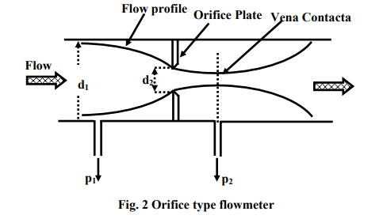
Orifice meter
Depending on the type of obstruction, we can have different types of flow meters.
Most common among them is the orifice type flowmeter, where an orifice plate is placed in the pipe line, as shown in fig.2. If d1 and d2 are the diameters of the pipe line and the orifice opening, then the flow rate can be obtained by measuring the pressure difference (p1-p2).
The major advantages of orifice plate are that it is low cost device, simple in construction and easy to install in the pipeline

Slide 10
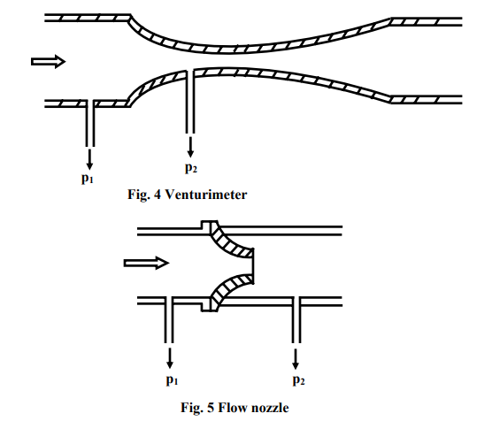
venturimeter
The construction of a venturimeter is shown in figure. Here it is so designed that the change in the flow path is gradual.
Flow nozzle is a compromise between orifice plate and venturimeter.
As a result, there is no permanent pressure drop in the flow path. The discharge coefficient Cd varies between 0.95 and 0.98. The construction also provides high mechanical strength for the meter.
However, the major disadvantage is the high cost of the meter.

Slide 11
Rotameter
The orificemeter, Venturimeter and flow nozzle work on the principle of constant area variable pressure drop. Here the area of obstruction is constant, and the pressure drop changes with flow rate.
On the other hand Rotameter works as a constant pressure drop variable area meter. It can be only be used in a vertical pipeline. Its accuracy is also less (2%) compared to other types of flow meters.
But the major advantages of rotameter are, it is simple in construction, ready to install and the flow rate can be directly seen on a calibrated scale, without the help of any other device, e.g. differential pressure sensor etc. Moreover, it is useful for a wide range of variation of flow rates (10:1).

Slide 12
The basic construction of a rotameter is shown in fig. 7. It consists of a vertical pipe, tapered downward. The flow passes from the bottom to the top. There is cylindrical type metallic float inside the tube. The fluid flows upward through the gap between the tube and the float. As the float moves up or down there is a change in the gap, as a result changing the area of the orifice. In fact, the float settles down at a position, where the pressure drop across the orifice will create an upward thrust that will balance the downward force due to the gravity. The position of the float is calibrated with the flow rate.

Slide 13
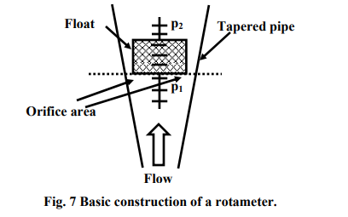
Rotameter

Slide 14
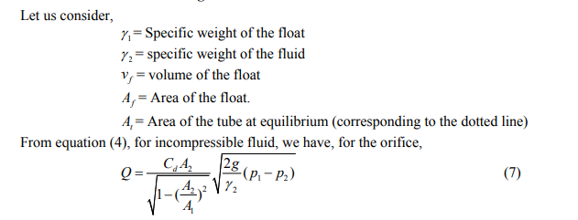

Slide 15
Construction of the float
Construction of the float
The construction of the float decides heavily, the performance of the rotameter.
In general, a float should be designed such that: (a) it must be held vertical (b) it should create uniform turbulence so as to make it insensitive to viscosity (c) it should make the rotameter least sensitive to the variation of the fluid density.
A typical construction of the float is shown in fig. 9. The top section of the float has a sharp edge and several angular grooves. The fluid passing through these grooves, causes the rotation of the float. The turbulence created in this process reduces the viscous force considerably.

Slide 16
Electromagnetic Flowmeter
Electromagnetic flowmeter is different from all other flowmeters due to its uniqueness on several accounts.
The advantages of this type of flowmeter can be summarized as:
It causes no obstruction to flow path.
It gives complete linear output in form of voltage.
The output is unaffected by changes in pressure, temperature and viscosity of the fluid.
4. Reverse flow can also be measured.
5. Flow velocity as low as 10-6m/sec can be measured.

Slide 17
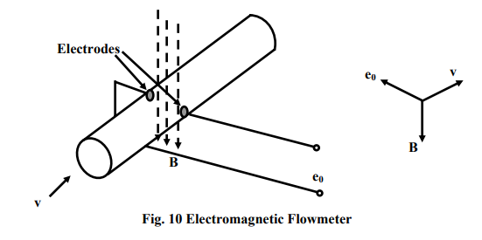
Electromagnetic Flowmeter

Slide 18
Electromagnetic Flowmeter
Electromagnetic flowmeters are suitable for measurement of velocity of conducting (Mercury) and weakly conducting (water) liquid.
The basic principle of operation can be understood from fig. 10.
It works on the principle of basic electromagnetic induction; i.e. when a conductor moves along a magnetic field perpendicular to the direction of flow, a voltage would be induced perpendicular to the direction of movement as also to the magnetic filed. The flowing liquid acts like a conductor. External magnetic field is applied perpendicular to the direction of the flow and two electrodes are flushed on the wall of the pipeline as shown.
The expression for the voltage induced is given by:

Slide 19
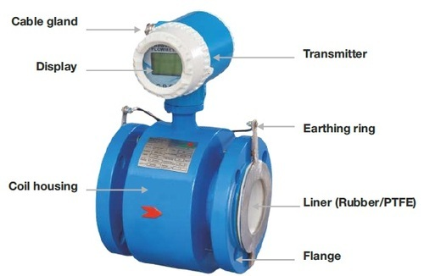
Electromagnetic Flowmeter

Slide 20
where l is the length of the conductor (diameter d in this case) and v is the velocity of the liquid.
The above expression shows the complete relationship between the voltage induced and the velocity. However, the magnetic field applied is not d.c. if the liquid medium is water or any other polarizable liquid. This is because, if the magnetic field is d.d. the voltage induced will also be d.c. and a small amount of d.c. current will flow if a measuring circuit is connected to the terminals.
This small d.c. current will cause electrolysis; oxygen and hydrogen bubbles will be formed and they will stick to the electrodes surfaces for some time. This will provide an insulating layer on the electrodes surfaces that will disrupt the voltage generation process. As a result, the magnetic field applied for these cases is a.c., or pulsed d.c. excitation. The meter can only be used for liquids having moderate conductivities (more than 10 μmho cm / ). As a result, it is not suitable for gases or liquid hydrocarbons. The accuracy is around±1%.

Slide 21
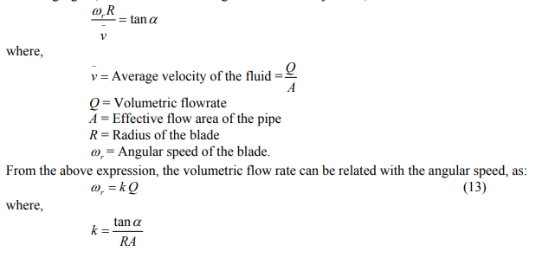
Turbine type Flowmeter
Turbine type flowmeter is a simple way for measuring flow velocity.
A rotating shaft with turbine type angular blades is placed inside the flow pipe. The fluid flowing through the pipeline will cause rotation of the turbine whose speed of rotation can be a measure of the flowrate. Referring fig.11, let blades make an angle α with the body. Then,

Slide 22
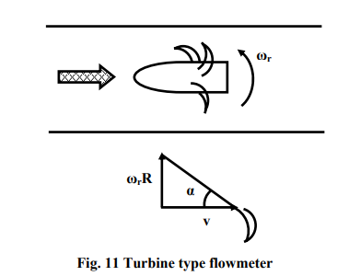
Turbine type Flowmeter
The speed of rotation of the turbine can be measured using several ways, such as, optical method, inductive pick up etc.

Slide 23
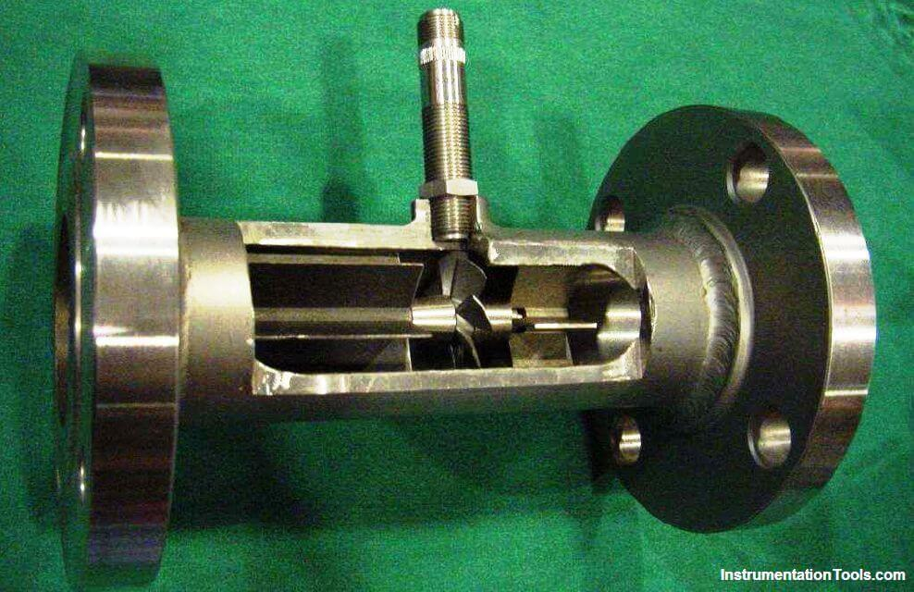
Turbine type Flowmeter

Slide 24
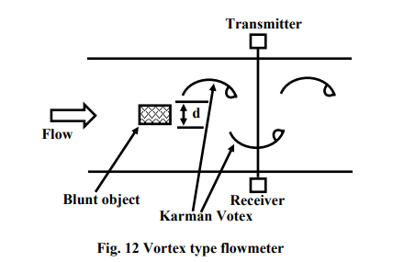
Vortex type Flowmeter
Formation of vortex on a flowing stream by an obstruction like straw or stone is a common observation. But what is probably not commonly known is the fact that, the frequency of vortex formation is proportional to flow velocity.

Slide 25
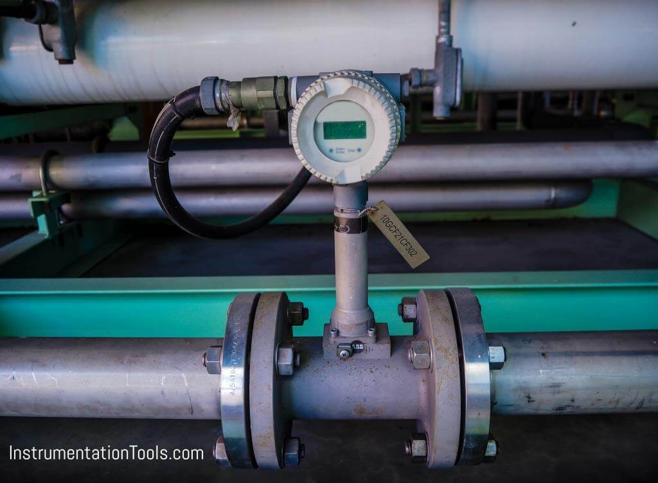
Vortex type Flowmeter

Slide 26
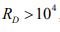
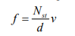
Vortex type Flowmeter
Fig.12 shows the basic principle of vortex type flowmeter. It is based on the principle of vertex shading. When a blunt object is placed on the passage of a flowing stream, vortices are formed. A vortes of this sort is called Karman Vortex. If the flow is turbulent and the Reynold’s number is , then the frequency of vortex formation is given by:
Where, d= width of the blunt object.
v= velocity of the fluid
Nst = A constant, called Strouhal Number.

Slide 27
Vortex type Flowmeter
The fig. 12 shows a typical arrangement of measurement of frequency of vorticex formation using ultrasonic technique. Formation of a vortex will modulate the intensity of ultrasound received by the receiver, and the frequency of modulation can be measured easily.

Slide 28
Ultrasonic Flow Meter
Ultrasonic flow meter measure fluid velocity by passing high-frequency sound waves along the fluid flow path.
Fluid motion influences the propagation of these sound waves, which may then be measured to infer fluid velocity.
Two major sub-types of ultrasonic flow meters exist:
Doppler and transit-time.
Both types of ultrasonic flowmeter work by transmitting a high-frequency sound wave into the fluid stream (the incident pulse) and analyzing the received pulse.

Slide 29
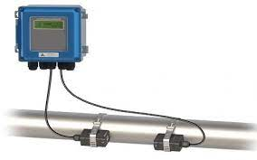
Ult FUltrasonic flow meter low Meter

Slide 30
Doppler flowmeters exploit the Doppler effect, which is the shifting of frequency resulting from waves emitted by or reflected by a moving object.
A common realization of the Doppler effect is the perceived shift in frequency of a horn’s report from a moving vehicle: as the vehicle approaches the listener, the pitch of the horn seems higher than normal; when the vehicle passes the listener and begins to move away, the horn’s pitch appears to suddenly “shift down” to a lower frequency.
In reality, the horn’s frequency never changes, but the velocity of the approaching vehicle relative to the stationary listener acts to “compress” the sonic vibrations in the air. When the vehicle moves away, the sound waves are “stretched” from the perspective of the listener.

Slide 31
The same effect takes place if a sound wave is aimed at a moving object, and the echo’s frequency is compared to the transmitted (incident) frequency. If the reflected wave returns from a bubble advancing toward the ultrasonic transducer, the reflected frequency will be greater than the incident frequency.
If the flow reverses direction and the reflected wave returns from a bubble traveling away from the transducer, the reflected frequency will be less than the incident frequency.
This matches the phenomenon of a vehicle’s horn pitch seemingly increasing as the vehicle approaches a listener and seemingly decreasing as the vehicle moves away from a listener.
A Doppler flowmeter bounces sound waves off of bubbles or particulate material in the flow stream, measuring the frequency shift and inferring fluid velocity from the magnitude of that shift.

Slide 32
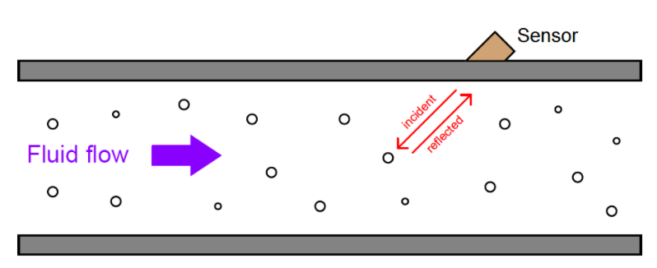
Ultrasonic Flow Meter – Doppler Flow meter

Slide 33
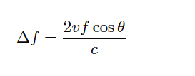
The requirement for there to be objects in the flow stream large enough to reflect sound waves limits Doppler ultrasonic flow meters to liquid applications.
Dirty liquids such as slurries and wastewater, or liquids carrying a substantial number of gas bubbles (e.g. carbonated beverages) are good candidate fluids for this technology.
It is unrealistic to expect that any gas stream will be carrying liquid droplets or solid matter large enough to reflect strong echoes, and so Doppler flow meters cannot be used to measure gas flow.
The mathematical relationship between fluid velocity (v) and the Doppler frequency shift (Δf) is as follows, for fluid velocities much less than the speed of sound through that fluid (v << c):

Slide 34
Where, Δf = Doppler frequency shift v = Velocity of fluid (actually, of the particle reflecting the sound wave) f = Frequency of incident sound wave θ = Angle between transducer and pipe centerlines c = Speed of sound in the process fluid
https://instrumentationtools.com/ultrasonic-flowmeters-animation/

Slide 35
Note how the Doppler effect yields a direct measurement of fluid velocity from each echo received by the transducer.
This stands in marked contrast to measurements of distance based on time-off light (time domain reflectometry – where the amount of time between the incident pulse and the returned echo is proportional to distance between the transducer and the reflecting surface)
such as in the application of ultrasonic liquid level measurement. In a Doppler flowmeter, the time delay between the incident and reflected pulses is irrelevant. Only the frequency shift between the incident and reflected signals matters.
This frequency shift is also directly proportional to the velocity of flow, making the Doppler ultrasonic flowmeter a linear measurement device.
Re-arranging the Doppler frequency shift equation to solve for velocity (again, assuming v << c)

Slide 36
A very important consideration for Doppler ultrasonic flow measurement is that the calibration of the flow meter varies with the speed of sound through the fluid (c).
This is readily apparent by the presence of c in the above equation: as c increases, Δf must proportionately decrease for any fixed volumetric flow rate Q.
Since the flowmeter is designed to directly interpret flow rate in terms of Δf, an increase in c causing a decrease in Δf will thus register as a decrease in Q.
This means the speed of sound for a fluid must be precisely known in order for a Doppler ultrasonic flowmeter to accurately measure flow.

Slide 37
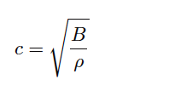
The speed of sound through any fluid is a function of that medium’s density and bulk modulus (how easily it compresses):
Where, c = speed of sound in a material (meters per second) B = Bulk modulus (pascals, or newtons per square meter) ρ = Mass density of fluid (kilograms per cubic meter)

Slide 38
Temperature affects liquid density, and composition (the chemical constituency of the liquid) affects bulk modulus. Thus, temperature and composition both are influencing factors for Doppler ultrasonic flowmeter calibration.
Pressure is not a concern here, since pressure only affects the density of gases, and we already know Doppler flowmeters only function with liquids.
Following on the theme of requiring bubbles or particles of sufficient size, another limitation of Doppler ultrasonic flowmeters is their inability to measure flow rates of liquids that are too clean and too homogeneous. In such applications, the sound-wave reflections will be too weak to reliably measure.
Such is also the case when the solid particles have a speed of sound too close to the that of the liquid, since reflection happens only when a sound wave encounters a material with a markedly different speed of sound.
Doppler-type ultrasonic flowmeters are useless in applications where we cannot obtain strong sound-wave reflections.

Slide 39
Transit-time flowmeters
Transit-time flowmeters, sometimes called counterpropagation flowmeters, are an alternative to Doppler ultrasonic flowmeters.
A transit-time ultrasonic flowmeter uses a pair of opposed sensors to measure the time difference between a sound pulse traveling with the fluid flow versus a sound pulse traveling against the fluid flow.
Since the motion of fluid tends to carry a sound wave along, the sound pulse transmitted downstream will make the journey faster than a sound pulse transmitted upstream:

Slide 40
working principle
Ultrasonic flow meters operate using the transit-time differential method. The Transit-time differential measurement is based on a simple physical fact.
Imagine two canoes crossing a river on the same diagonal line, one with the flow and the other against the flow. The canoe moving with the flow needs much less time to reach the opposite bank

Slide 41
Ultrasonic waves behave exactly the same way. A sound wave travelling in the direction of flow of the product is propagated at a faster rate than one travelling against the flow (v_{down} > v_{up}).
Transit times t_{down} and t_{up} are measured continuously. The difference (t_{up} – t_{down}) in time travelled by the two ultrasonic waves is directly proportional to the mean flow velocity (vm).
Where,
t_{down} is Time required for ultrasonic wave to travel from top Sensor A to bottom B sensor
t_{up} is Time required for ultrasonic wave to travel from Sensor B to A sensor

Slide 42
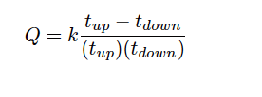
The rate of volumetric flow through a transit-time flowmeter is a simple function of the upstream and downstream propagation times:
Where, Q = Calculated volumetric flow rate k = Constant of proportionality t_{up} = Time for sound pulse to travel from downstream location to upstream location (upstream, against the flow) t_{down} = Time for sound pulse to travel from upstream location to downstream location (downstream, with the flow)

Slide 43
An interesting characteristic of transit-time velocity measurement is that the ratio of transit time difference over transit time product remains constant with changes in the speed of sound through the fluid.
If you would like to prove this to yourself, you may do so by substituting path length (L), fluid velocity (v), and sound velocity (c) for the times in the flow formula. Use tup = L/(c−v) and tdown = L/(c+v) as your substitutions, then algebraically reduce the flow formula until you find that all the c terms cancel. Your final result should be Q = 2kv/L .
When this equation is cast into terms of path length (L), fluid velocity (v), and sound velocity (c), the equation simplifies to Q = 2kv/L , proving that the transit-time flow meter is linear just like the Doppler flowmeter, with the advantage of being immune to changes in the fluid’s speed of sound.
Changes in bulk modulus resulting from changes in fluid composition, or changes in density resulting from compositional, temperature, or pressure variations therefore have little effect on a transit-time flow meter’s accuracy.
Not only are transit-time ultrasonic flow meters immune to changes in the speed of sound, but they are also able to measure that sonic velocity independent of the flow rate.

Slide 44
A requirement for reliable operation of a transit-time ultrasonic flow meter is that the process fluid be free from gas bubbles or solid particles which might scatter or obstruct the sound waves.
Note that this is precisely the opposite requirement of Doppler ultrasonic flow meters, which require bubbles or particles to reflect sound waves.
These opposing requirements neatly distinguish applications suitable for transit-time flow meters from applications suitable for Doppler flow meters, and also raise the possibility of using transit-time ultrasonic flow meters on gas flow streams as well as on liquid flow streams.

Slide 45
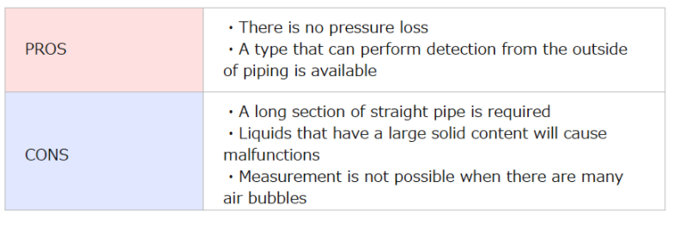
Pros and Cons of ultrasonic flow meter

Slide 46
What is an Anemometer?
Anemometer – measures gas speed
Types
rotating cup
pitot static tube
thermal (hot wire)
also performs temperature measurement

Slide 47
Theory of Operation
Energy Balance
Constant temperature or constant current operation
Measure change in current or change in temperature
Correlate I or T_{wire} to gas velocity based on convective H.T. and fluid dynamics

Slide 48
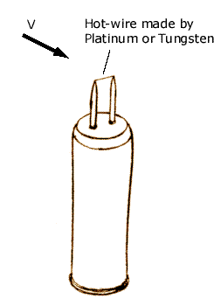
Probe
Tungsten or Platinum filament
~1 mm long
4-10 mm diameter
Benefits
Good spatial resolution
Flat frequency response
Limitations
Fragile
Requires clean flow
Cost (start at $300-400)

Slide 49
Interfacing
Wide variety of options
Devices typically come with some sort of m-controller
Depends on application
Handheld vs. in-situ
Most common
Serial RS232 – for sampled data collection and control
Larger selection for industrial sensors
Serial RS232, RS485
Analog 4-20 mA, 0-10V
Profibus, Modbus, etc.

Slide 50
Typical Specifications
 | Handheld/Economy | Industrial Grade
Measurable velocities | 0.2-20 m/s | 0.2-90 m/s
Operating temp ranges | 0-50 °C | -40-200 °C
Velocity Accuracy | ± 3% reading | ± 1% reading
Time constant | 200 ms | 100 ms
Interfacing options | Handheld reader, RS232 | RS232, RS485, voltage, 4-20 mA, Modbus, Profibus, etc.

Slide 51
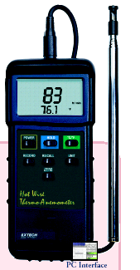
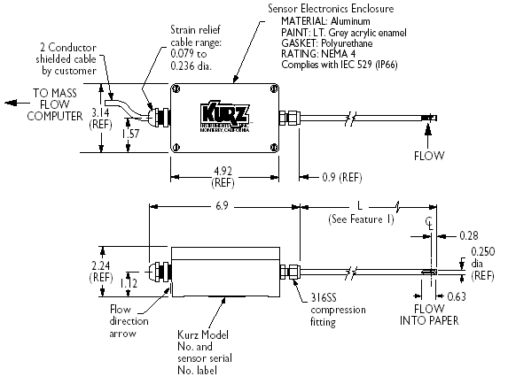

Slide 52
Hot wire Anemometer
A thermal anemometer measures the velocity at a point in a flowing fluid — a liquid or a gas.
A typical industrial thermal anemometer used to monitor velocity in gas flows has two sensors —
a velocity sensor and a temperature sensor —
that automatically correct for changes in gas temperature.
Both sensors are reference-grade platinum resistance temperature detectors (RTDs).
The electric resistance of RTDs increases as temperature increases.
For this reason, they are one of the most commonly used sensors for accurate temperature measurements.

Slide 53
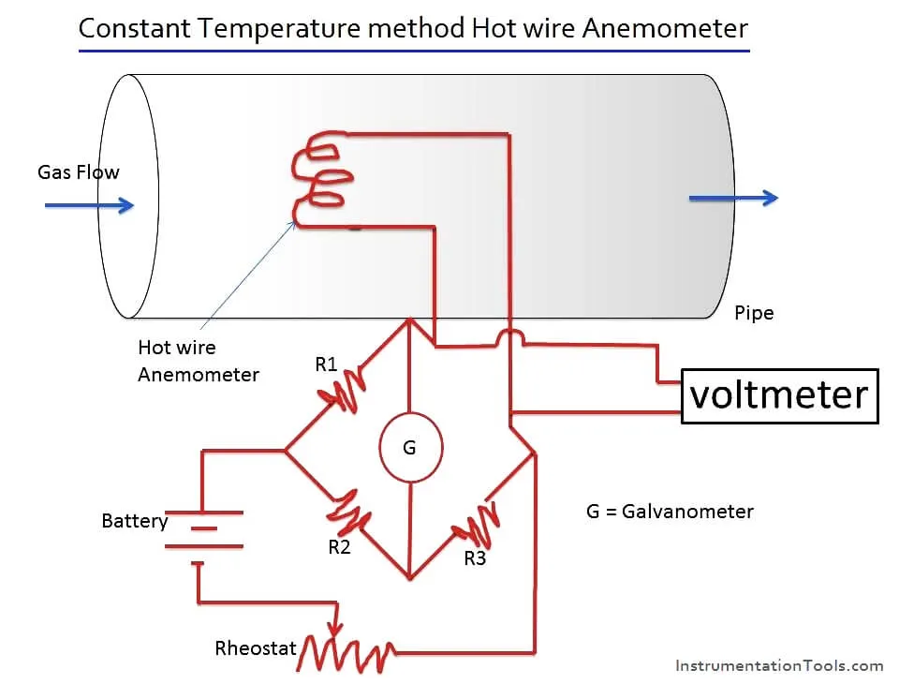
Hot Wire Anemometer works When an electrically heated wire is placed in a flowing gas stream, heat is transferred from the wire to the gas and hence the temperature of the wire reduces, and due to this, the resistance of the wire also changes. This change in resistance of the wire becomes a measure of flow rate.

Slide 54
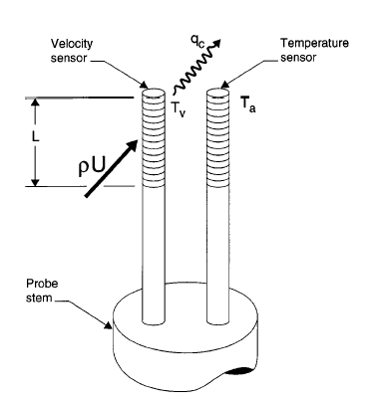
The electronics circuit passes current through the velocity sensor, thereby heating it to a constant temperature differential (T_{v} – T_{a}) above the gas temperature T_{a} and measures the heat q_{c} carried away by the cooler gas as it flows past the sensor.
Hence, it is called a “constant-temperature thermal anemometer.”

Slide 55
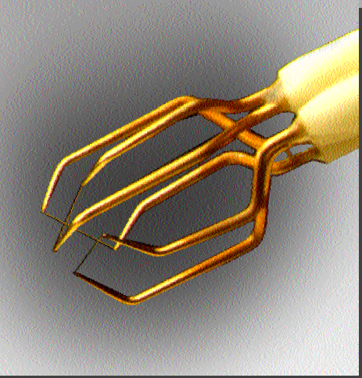
Three Wire Anemometer

Slide 56
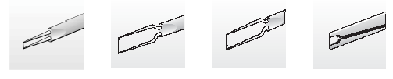
Sensor Types
Miniature wires
Gold-plated
wires
Fibre-film
Film-sensors
Wires are normally 5 µm in diameter and 1.2 mm long suspended between two needle-shaped prongs.
Gold-plated wires have the same active length but are copper- and gold-plated at the ends to a total length of 3 mm long in order to minimise prong interference.

Slide 57
Fibre-sensors are quartz-fibers, normally 70 µm in diameter and with 1.2 mm active length, covered by a nickel thin-film, which again is protected by a quartz coating.
Fibre-sensors are mounted on prongs in the same arrays as are wires.
Film sensors consist of nickel thin-films deposited on the tip of aerodynamically shaped bodies, wedges or cones.

Slide 58
Displacement Measurement
A displacement sensor (displacement gauge) is primarily used to measure the range of where an object has to travel and in relation to a reference position.
Displacement sensors have multiple uses.
Its primary use is for dimension measurement to figure out an object's width, height, and thickness.
Types
Potentiometer.
Linear variable differential Transformer(LVDT)
Accelerometers

Slide 59
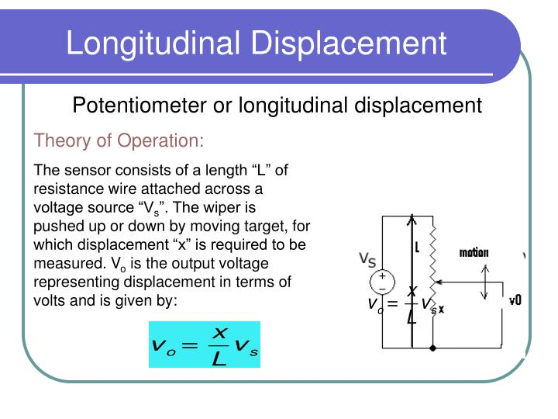

Slide 60
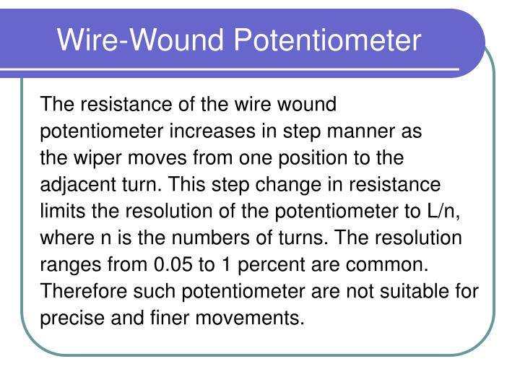
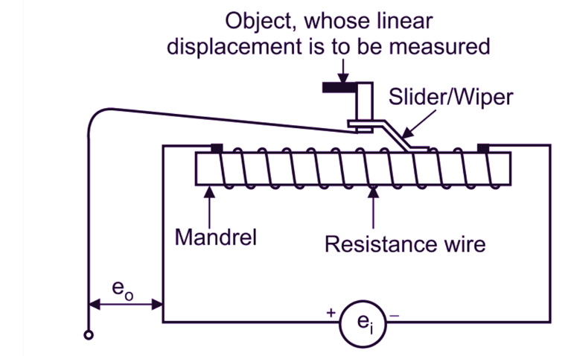

Slide 61
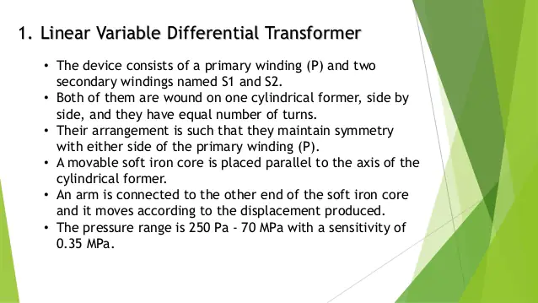

Slide 62
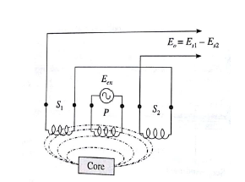
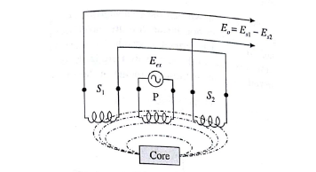
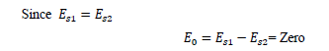
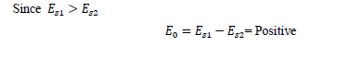
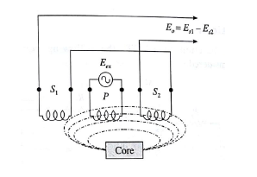
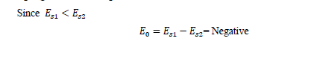

Slide 63
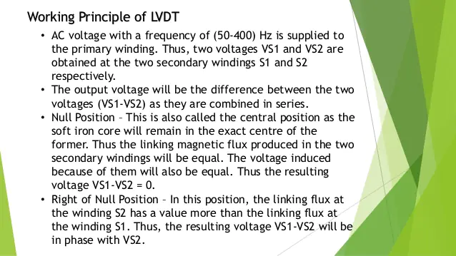

Slide 64
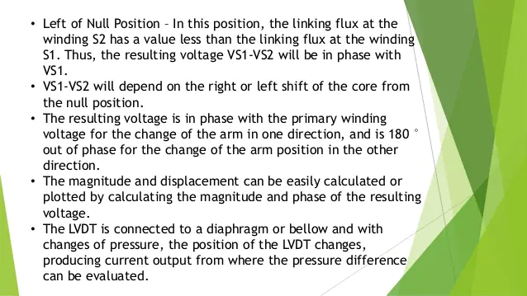

Slide 65
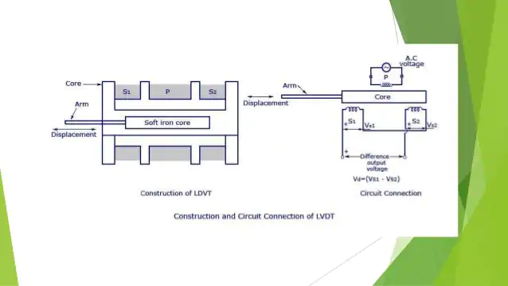

Slide 66
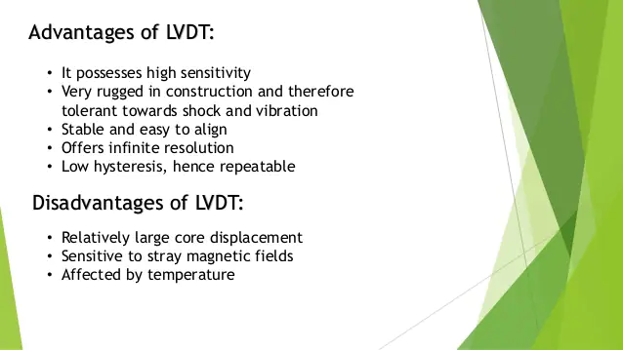

Slide 67
Measurement of Speed

Slide 68
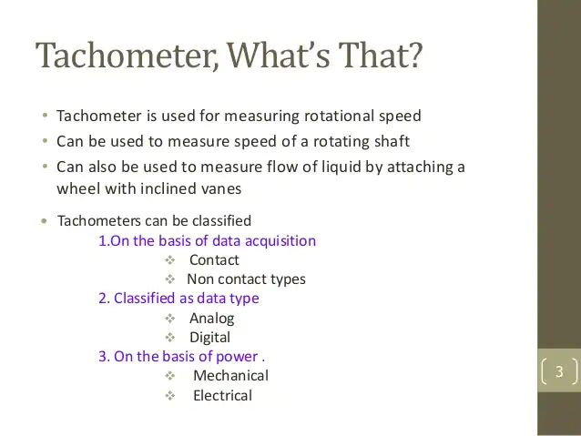

Slide 69
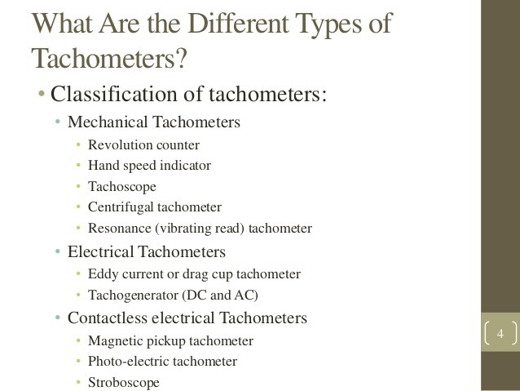

Slide 70
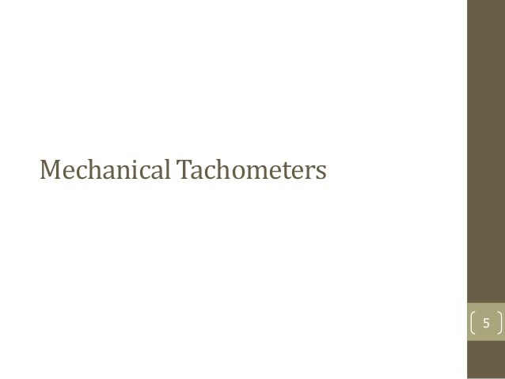

Slide 71
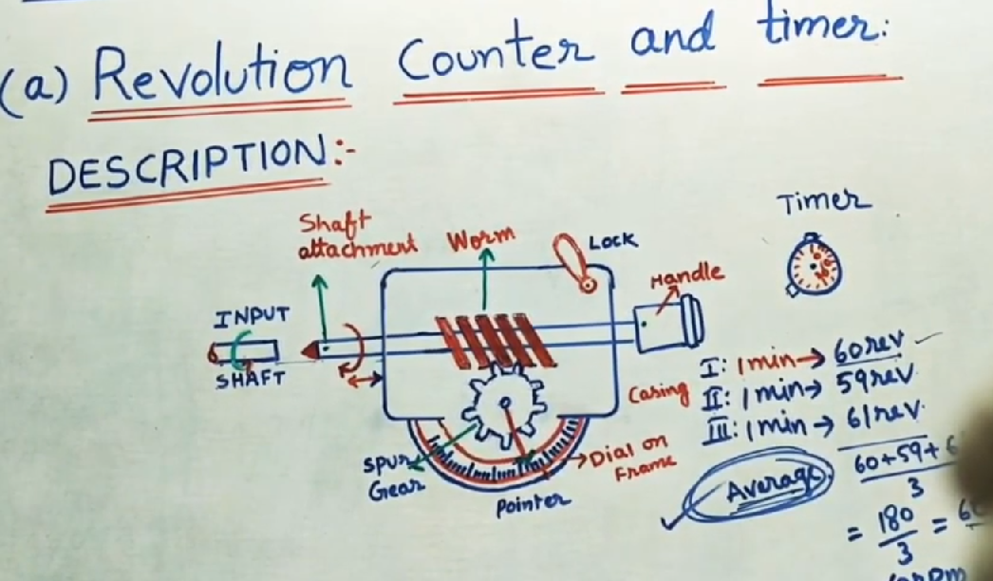

Slide 72
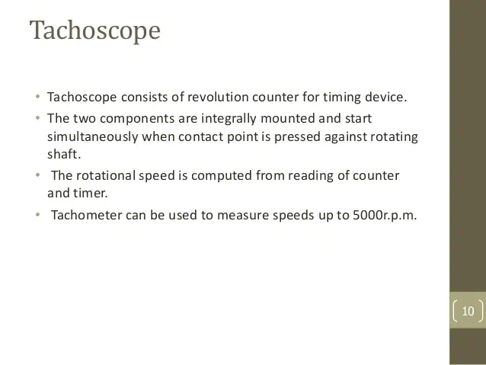



Slide 73



Slide 74



Slide 75


Slide 76


Slide 77


Slide 78


Slide 79


Slide 80


Slide 81


Slide 82


Slide 83


Slide 84


Slide 85


Slide 86
Non-contact type – It is also known as photo tachometer or non-touch tachometer. This type of device doesn’t need any physical contact with the rotating shaft. It uses a laser, infrared light, or other light sources to take the measurements. The device sends out the beam of light. This beam reflects each time a tape makes a full rotation. The receiver needs to count these reflections during the process to measure the rotational speed in RPM. This type of tachometer is efficient, durable, accurate, and compact.

Slide 87


Slide 88


Slide 89


Slide 90


Slide 91


Slide 92


Slide 93


Slide 94


Slide 95


Slide 96


Slide 97


Slide 98


Slide 99


Slide 100


Slide 101


Slide 102


Slide 103


Slide 104


Slide 105


Slide 106


Slide 107


Slide 108


Slide 109


Slide 110

https://www.youtube.com/watch?v=sHmjE21Fp9w (nptel)

Slide 111


Slide 112


Slide 113


Slide 114


Slide 115

h-height difference ; p-density of fluid

Slide 116


Slide 117


Slide 118


Slide 119


Slide 120


Slide 121


Slide 122


Slide 123


Slide 124


Slide 125


Slide 126


Slide 127


Slide 128


Slide 129



diaphragm has elastic property
Vacuum pressure-zero value- removed all molecules from the particular space

Slide 130


Differential pressure= applied pressure –atmospheric pressure

Slide 131

skip

Slide 132

skip

Slide 133

skip

Slide 134


Slide 135

bellow act as elastic material. By Appling pressure, with elastic spring, it will expand and compress

Slide 136


Slide 137


Slide 138

bellow act as elastic material. By Appling pressure, with elastic spring, it will expand and compress

Slide 139


According to Pressure1, pressure 2 the arm will move.so, it shows reading on scale

Slide 140


Slide 141


Slide 142


Slide 143


Slide 144


Slide 145


Slide 146


Slide 147


Slide 148


Slide 149


Slide 150


Slide 151


Slide 152


Slide 153


Slide 154

https://www.youtube.com/watch?v=nbMBCEOZIS4&list=PLF404D44A280B5C77&index=44

Slide 155

Pressure sensors

Slide 156
Pressure is a very important parameter in on boardautomobiles and pressure of intake manifold,engine oil,brake oil,tyres,room atmosphere and so on need to be measured.
The conventional diaphragms and bellow elements in association with strain gauge,LVDT,Capacitive elements arealready in use for pressure measurement.
The semiconductor capacitive devices and SAW devices are being increasinglyused fromwhich high frequency output can bederivedfor easier signal processing
With applied pressure, a crystal oscillator changes its frequency and isbeing tried as PZT type devices.
Such a pressure sensor processed by semiconductor technology and MEMS is shown in fig 9.2
For negative pressure sensing for the intake manifold , a semi smart sensor is used

Slide 157


Slide 158
Amplification , calibration and temperature compensation are internally made for in the sensor using IC technology.
A basic sensor unit uses a silicon diaphragm and a vacuum chamber is created.The sensor unit is in fig 9.3.
The sensing silicon chip is resistive in nature and is obtained by adding appropriate impurity to the diffused design.

Slide 159
Measuring Vibration

Slide 160
Measuring Vibration with Accelerometers
What is vibration?
Vibration is the movement or mechanical oscillation about an equilibrium position of a machine or component. It can be periodic, such as the motion of a pendulum, or random, such as the movement of a tire on a gravel road. Vibration can be expressed in metric units (m/s²) or units of gravitational constant “g,” where 1 g = 9.81 m/s². An object can vibrate in two ways: free vibration and forced vibration.
Free vibration occurs when an object or structure is displaced or impacted and then allowed to oscillate naturally. For example, when you strike a tuning fork, it rings and eventually dies down. Natural frequency often refers to the frequency at which a structure “wants” to oscillate after an impact or displacement. Resonance is the tendency for a system to oscillate more violently at some frequencies than others. Forced vibration at or near an object’s natural frequency causes energy inside the structure to build. Over time the vibration can become quite large even though the input forced vibration is very small. If a structure has natural frequencies that match normal environmental vibration, then the structure vibrates more violently and prematurely fails.

Slide 161

Forced vibration occurs when a structure vibrates because an altering force is applied. Rotating or alternating motion can force an object to vibrate at unnatural frequencies. An example of this is imbalance in a washing machine, where the machine shakes at a frequency equal to the rotation of the turnstile. In condition monitoring, vibration measurements are used to indicate the health of rotating machinery such as compressors, turbines, or pumps. These machines have a variety of parts, and each part contributes a unique vibration pattern or signature. By trending different vibration signatures over time, you can predict when a machine will fail and properly schedule maintenance for improved safety and reduced cost.

Slide 162

LVDT ACCELEROMETER

Slide 163

PIEZO-ELECTRIC ACCELEROMETER

Slide 164

SEISMIC AS ACCELEROMETER
Due to machine vibration, damper and spring vibrates. Due to this, mass gives displacement. This displacement
Converted into voltage through Wheatstone bridge.

Slide 165





Slide 166


Slide 167


STRAIN GAUGE ACCELEROMETER

Slide 168
How do you measure vibration?
Vibration is most commonly measured using a ceramic piezoelectric sensor or accelerometer.
An accelerometer is a sensor that measures the dynamic acceleration of a physical device as a voltage. Accelerometers are full-contact transducers typically mounted directly on high-frequency elements, such as rolling-element bearings, gearboxes, or spinning blades.
These versatile sensors can also be used in shock measurements (explosions and failure tests) and slower, low-frequency vibration measurements.
The benefits of an accelerometer include linearity over a wide frequency range and a large dynamic range.

Slide 169


Slide 170
Another sensor you can use to measure vibration is the proximity probe.
Unlike accelerometers, which measure acceleration to determine vibration, proximity probes are noncontacting transducers that measure distance to a target. These sensors are almost exclusively used in rotating machinery to measure the vibration of a shaft.
An example of a common application is machine monitoring and protection measurements for mechanical systems like turbo machinery. Because of the flexible fluid film bearings and heavy housing, vibrations do not transmit well to the outer casing, so you use proximity probes instead of accelerometers to directly measure shaft motion.

Slide 171
How do accelerometers work?
Most accelerometers rely on the use of the piezoelectric effect, which occurs when a voltage is generated across certain types of crystals as they are stressed.
The acceleration of the test structure is transmitted to a seismic mass inside the accelerometer that generates a proportional force on the piezoelectric crystal.
This external stress on the crystal then generates a high-impedance, electrical charge proportional to the applied force and, thus, proportional to the acceleration.

Slide 172


Slide 173
Piezoelectric or charge mode accelerometers require an external amplifier or inline charge converter to amplify the generated charge, lower the output impedance for compatibility with measurement devices, and minimize susceptibility to external noise sources and crosstalk.
Other accelerometers have a charge-sensitive amplifier built inside them. This amplifier accepts a constant current source and varies its impedance with respect to a varying charge on the piezoelectric crystal.
These sensors are referred to as Integrated Electronic Piezoelectric (IEPE) sensors. Measurement hardware made for these types of accelerometers provide built in current excitation for the amplifier. You can then measure this change in impedance as a change in voltage across the inputs of the accelerometer.

Slide 174
To choose the right accelerometer
Different electrical and physical specifications for accelerometers.
1.Vibration Amplitude
The maximum amplitude or range of the vibration you are measuring determines the sensor range that you can use. If you attempt to measure vibration outside a sensor’s range, it distorts or clips the response. Typically, accelerometers used to monitor high vibration levels have a lower sensitivity and lower mass.

Slide 175
2.Sensitivity
Sensitivity is one of the most important parameters for accelerometers.
It describes the conversion between vibration and voltage at a reference frequency, such as 160 Hz. Sensitivity is specified in mV per G. If typical accelerometer sensitivity is 100 mV/G and you measure a 10 G signal, you expect a 1000 mV or 1 V output.
The exact sensitivity is determined from calibration and usually listed in the calibration certificate shipped with the sensor. Sensitivity is also frequency dependent.
A full calibration across the usable frequency range is required to determine how sensitivity varies with frequency.
Figure 4 shows the typical frequency response characteristics of an accelerometer.
In general, use a low sensitivity accelerometer to measure high amplitude signals and a high sensitivity accelerometer to measure low amplitude signals

Slide 176


Slide 177
3.Number of Axes
You can choose from two axial types of accelerometers. The most common accelerometer measures acceleration along only a single axis.
This type is often used to measure mechanical vibration levels. The second type is a triaxial accelerometer.
This accelerometer can create a 3D vector of acceleration in the form of orthogonal components. Use this type when you need to determine the type of vibration, such as lateral, transverse, or rotational.

Slide 178
4. Weight
Accelerometers should weigh significantly less than the structure you are monitoring.
Adding mass to the structure can alter its vibrational characteristics and potentially lead to inaccurate data and analysis.
The weight of the accelerometer should generally be no greater than 10 percent of the weight of the test structure.

Slide 179
Another consideration for your vibration measurement system is how to mount the accelerometer to the target surface. You can choose from four typical mounting methods:
Handheld or probe tips
Magnetic
Adhesive
Stud mount
Stud mounting is by far the best mounting technique, but it requires you to drill into the target material and is generally reserved for permanent sensor installation. The other methods are meant for temporary attachment. The various attachment methods all affect the measurable frequency of the accelerometer. Generally speaking, the looser the connection, the lower the measurable frequency limit. The addition of any mass to the accelerometer, such as an adhesive or magnetic mounting base, lowers the resonant frequency, which may affect the accuracy and limits of the accelerometer’s usable frequency range. Consult accelerometer specifications to determine how different mounting methods affect the frequency measurement limits. Table 1 shows typical frequency limits for a 100 mV/G accelerometer.

Slide 180


Slide 181

Figure 5 shows the approximate frequency ranges of different mounting techniques, including stud mounts, adhesive mounts, magnet mounts, and triax block mounts.

Slide 182
5.Environmental Constraints
When choosing an accelerometer, pay attention to critical environmental parameters such as maximum operating temperature, exposure to harmful chemicals, and humidity. You can use most accelerometers in hazardous environments because of their rugged and reliable construction. For additional protection, industrial accelerometers built from stainless steel can protect the sensors from corrosion and chemicals.
Use a charge mode accelerometer if the system must operate in extreme temperatures. Since these accelerometers do not contain built-in electronics, the operating temperature is limited only by the sensing element and materials used in the construction. However, since they do not have built-in conditioning and charge amplification, charge mode accelerometers are sensitive to environmental interference and require low-noise cabling. If the environment is noisy, you should use an inline charge converter or IEPE sensor with a built-in charge amplifier.
Humidity specifications are defined by the type of seal an accelerometer has. Common seals include hermetic, epoxy, or environmental. Most of these seals can withstand high levels of moisture, but a hermetic seal is recommended for fluid immersion and long exposure to excessive humidity.

Slide 183
6.Cost
Although charge mode and IEPE accelerometers have similar costs, IEPE accelerometers have a significantly lower cost for larger, multichannel systems because they do not require special low-noise cables and charge amplifiers. In addition, IEPE accelerometers are easier to use because they require less care, attention, and effort to operate and maintain.

Slide 184


Single axis accelerometer
Triaxial accelerometer

Slide 185
Signal conditioning for accelerometers
When preparing an accelerometer to be measured properly by a DAQ device, you need to consider the following to ensure you meet all of your signal conditioning requirements:
Amplification to increase measurement resolution and improve signal-to-noise ratio
Current excitation to power the charge amplifier in IEPE sensors
AC coupling to remove DC offset, increase resolution, and take advantage of the full range of the input device
Filtering to remove external, high-frequency noise
Proper grounding to eliminate noise from current flow between different ground potentials
Dynamic range to measure the full amplitude range of the accelerometer

Slide 186


